Slide 1
Principle Component Analysis (PCA)
These slides are taken from Prof. Jiashi Feng’s slides.

Slide 2

What we are doing with Pattern Recognition
Raw Data
Extract Informative
Pattern Representation
?
PR Model (after training)
Recognition Results
“Jack Ma”
Notes:
Not study feature design

Slide 3
Outlines
Pattern Representation Learning
Unsupervised Representation Learning (PCA, NMF)
Supervised Representation Learning (LDA, GE)
Clustering and Applications
Patter Recognition Models
Gaussian Mixture Model and Boosting
Support Vector Machines
Deep Learning (a.k.a. deep neural networks)

Slide 4
Outlines
Representation Learning
Unsupervised Representation Learning (PCA, NMF)
Supervised Representation Learning (LDA, GE)
Clustering and Applications
Patter Recognition Models
Gaussian Mixture Model and Boosting
Support Vector Machines
Deep Learning (a.k.a. deep neural networks)

Slide 5
Unsupervised Feature Learning
Principal Component Analysis

Slide 6
Representation Learning / Extraction
Representation learning refers to transforming the raw data into another (possibly lower-dimensional) space.
Such that, in the new space, one can perform pattern recognition more easily.
Criterion for good representation in different problem settings:
Unsupervised: minimize information loss (no class information)
Supervised: maximize discrimination (with class information)
Notes:
Change to another viewpoint to “observe” objects.

Slide 7

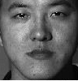
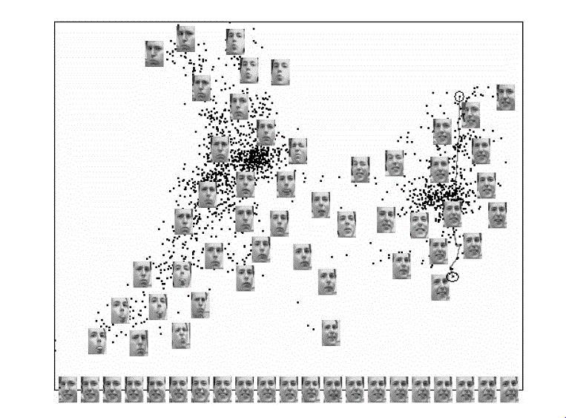
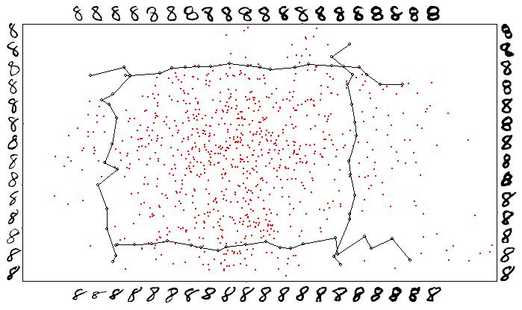
What is Feature Extraction
28 x 28 pixels
32 x 32 pixels
expression
shape
thickness
viewpoint
Features of Digit “8”
Features of Face
Notes:
Left figure: the raw image can be written as a feature vector of 28x28 dimensions. If selecting “thickness” and “shape” as the features to describe different “8”, each image of “8” can be represented by one point in 2-dimensional space. The representation is more concise and informative.
Right figure: similarly, using “expression” and “viewpoint” can represent a 32x32 face image by a point in 2-dim plane.

Slide 8
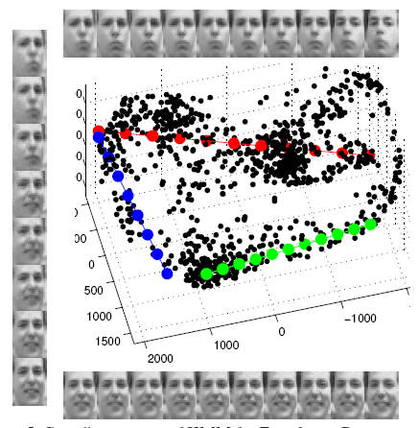
Why Feature Extraction?
Many pattern recognition techniques may not be effective for high-dimensional data
Curse of dimensionality
Computational cost increases rapidly along with the dimension increases
E.g. O(d²) here d is the dimension
Patterns may have small intrinsic dimension
E.g., # genes responsible for a certain disease may be small
E.g., face images of one person captured with different illumination conditions
Notes:
Curse of dimensionality (Bellman 1961) refers to the exponential growth of hypervolume as a function of dimensionality.

Slide 9
Why Feature Extraction?
Visualization: projecting high-dimensional data onto 2D or 3D planes
Data compression: efficient storage and retrieval
Noise removal: positive effect on testing accuracy

Slide 10
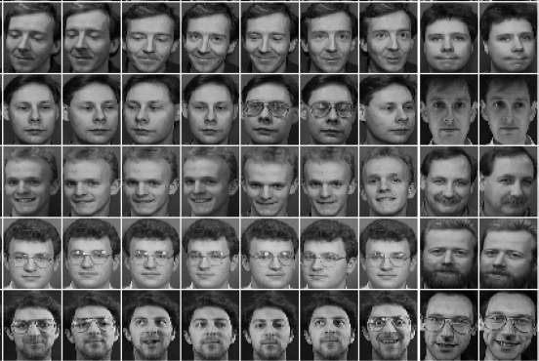
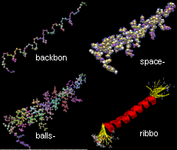
Applications of Feature Extraction
Face recognition
Handwritten digit recognition
Text mining
Image retrieval
Protein classification
Proteins
Face Images
Notes:
Why interesting or valuable

Slide 11
Feature Extraction Algorithms
Unsupervised (this lecture)
Principal Component Analysis (PCA)
Nonnegative Matrix Factorization (NMF)
Independent Component Analysis (ICA) [Reading]
Supervised (next lecture)
Linear Discriminant Analysis (LDA)
General Graph Embedding (GE)
Canonical Correlation Analysis (CCA) [Reading, encouraged]

Slide 12
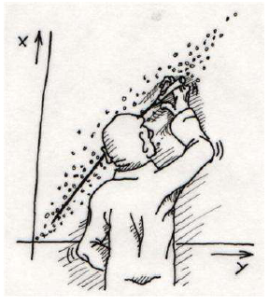
Principal Component Analysis (PCA)
Probably the most widely-used and well-known multivariate analysis method.
Introduced by Pearson (1901)
First applied in ecology by Goodall (1954) under the name “factor analysis”.
De facto data pre-processing operation.
Least square error data fitting
Pearson, K. (1901). "On Lines and Planes of Closest Fit to Systems of Points in Space" Philosophical Magazine 2 (11): 559–572.

Slide 13
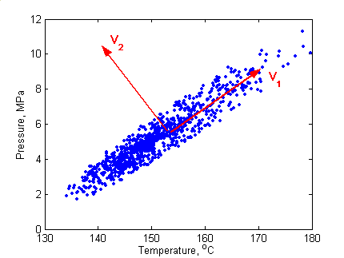
What is Principal Component Analysis?
Principal component analysis (PCA)
Reduce the dimensionality of a collection of observations by finding a new set of variables, smaller than the original set of variables
Capture big (principal) variability in
the data and ignore small variability
Variation in samples
The new variables, called principal components (PCs), are ordered by variations corresponding to different PCs.

Slide 14
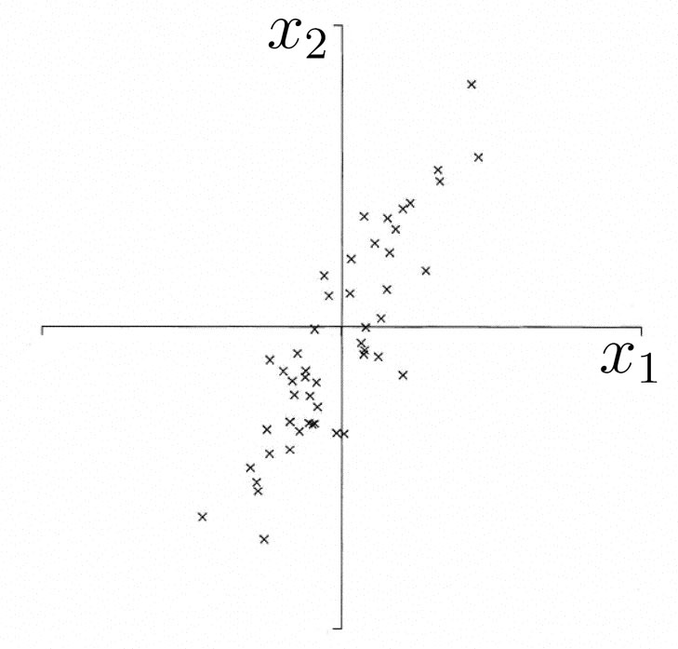
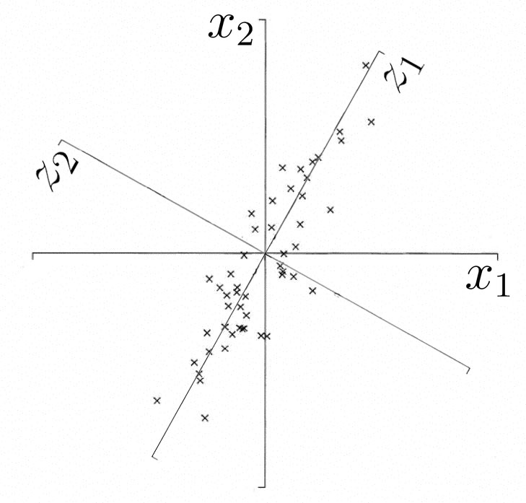
Geometric Picture of Principal Components
The 1st PC is a minimum distance fit to a line in X space
The 2nd PC is a minimum distance fit to a line in the
plane orthogonal to the 1st PC
PCs are a series of linear least squares fits to a sample set,
each orthogonal to all the previous ones.

Slide 15
Geometric Picture of Principal Components
Sample Points

Slide 16
Geometric Picture of Principal Components
linear least squares fit: Large

Slide 17
Geometric Picture of Principal Components
linear least squares fit: Small

Slide 18
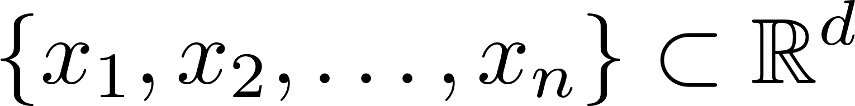
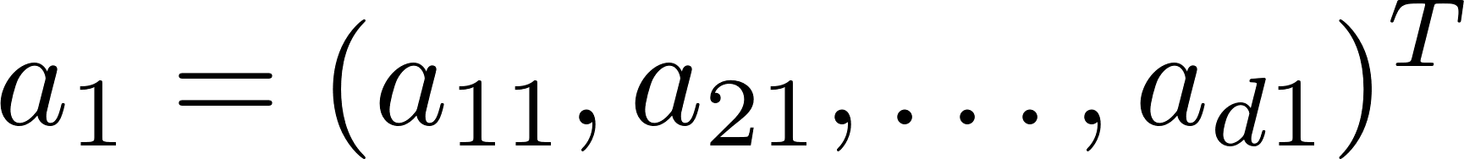

Algebraic Definition of PCs
Given a sample set of n observations on a vector of d variables
define the first principal component by the linear projection
$$a_{1}$$
where the vector
is chosen such that
is maximum.
Notes:
information

Slide 19
Algebraic Definition of PCs
To find first note that
where
is the covariance matrix,

Slide 20
Algebraic Derivation of PCs
To find that maximizes subject to
Let λ be a Lagrange multiplier
therefore
is an eigenvector of S
corresponding to the largest eigenvalue
Notes:
Why?

Slide 21
Algebraic Derivation of PCs
Similarly, is also an eigenvector of S
whose eigenvalue is the second largest.
In general
The k^{th} largest eigenvalue of S is the variance of the k^{th} PC.
The k^{th} PC retains the k^{th} greatest variation in the samples
Notes:
Orthogonal automatically satisfied

Slide 22
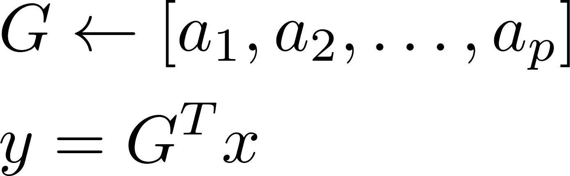
Algebraic Derivation of PCs
Main steps for computing PCs
Calculate the covariance matrix S.
Compute its eigenvectors:
The first p eigenvectors form the p PCs.
The transformation matrix G consists of the p PCs:

Slide 23
Practical Computation of PCA
In practice, we compute the PCs via singular value decomposition (SVD) on the centered data matrix.
Form the centered data matrix:
Compute its SVD:
U and V are orthogonal matrices, D is a diagonal matrix

Slide 24
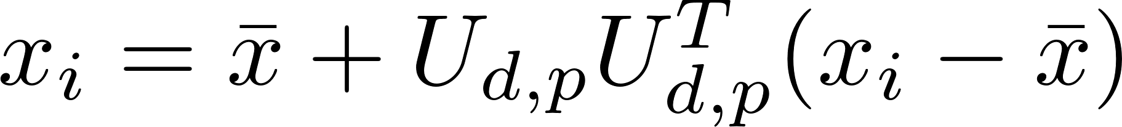
Practical Computation of PCA
Note that the scatter/covariance matrix can be written as:
The eigenvectors of S are the columns of U, and the eigenvalues are the diagonal elements of D ²
Take only a few significant eigenvalue-eigenvector pairs p << d. The new reconstructed sample from low-dim space is:

Slide 25
PCA and Classification
Classification with PCA
Project both training and testing data into the PCs space
For each testing datum, use NN for classification
Issue: accuracy is sensitive to the number of PCs
PCA is not always an optimal feature
extraction procedure for classification purpose
Suppose there are C classes in the training data
PCA is based on the sample covariance which characterizes the scatter of the entire data set, irrespective of class-membership
The projection axes chosen by PCA might not provide good discrimination power
How to determine the number of PCs?

Slide 26
How many principal components to keep?
To choose p based on percentage of variation to retain, we can use the following criterion (smallest p):

Slide 27
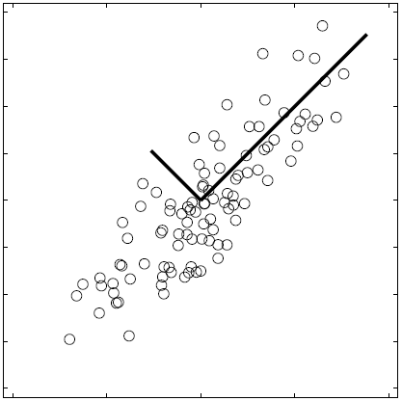
Visualize PCs
Data points are represented in a rotated orthogonal coordinate system: the origin is the mean of the data points and the axes are provided by the eigenvectors.

Slide 28
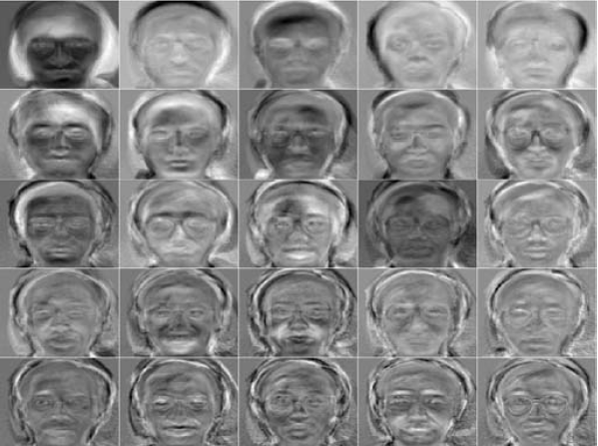
Visualize PCs
Eigenfaces, how to plot like this?
Face images

Slide 29
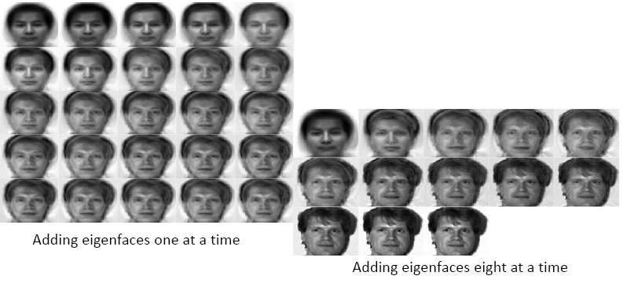
Reconstruction with PCs

Slide 30
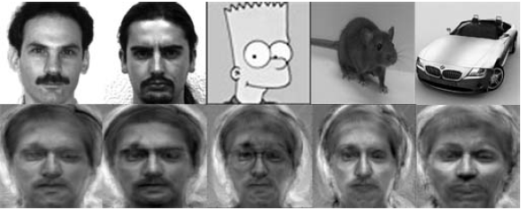
What shall happen for Other Objects
For faces of person not in training set or non-faces (upper), what shall the reconstruction results (bottom) be?

Slide 31
PCA Remarks
PCA
finds orthonormal basis for data
Sorts dimensions in order of “importance”
Discard low significance dimensions
Uses:
Get compact description
Ignore noise
Improve classification (hopefully)

Slide 32
PCA Remarks
PCA cannot capture NON-LINEAR structure!
Note: Curvilinear Component Analysis can solve this case. Study this work if you are interested.

Slide 33
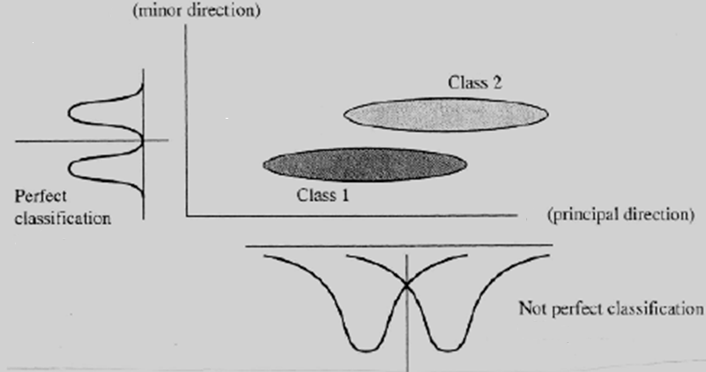
PCA doesn’t know class labels
So LDA next week!
Notes:
Another solution for PCA

Slide 34
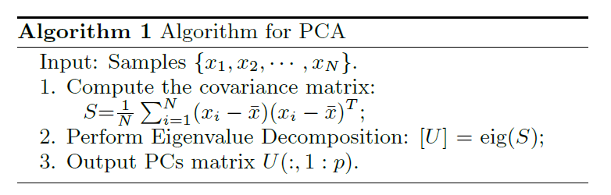
Summary of PCA

Slide 35
Discussions
What can we do with PCA (given that it is generally worse for classification than other supervised algorithms)?

Slide 36
Unsupervised Feature Extraction II:
Nonnegative Matrix Factorization

Slide 37
A Quick Review of Linear Algebra
Every vector can be expressed as the linear combination of basis vectors
Can think of images as big vectors
(Raster scan image into vector)
This means we can express an image as the linear combination of a set of basis images

Slide 38
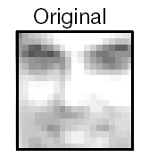
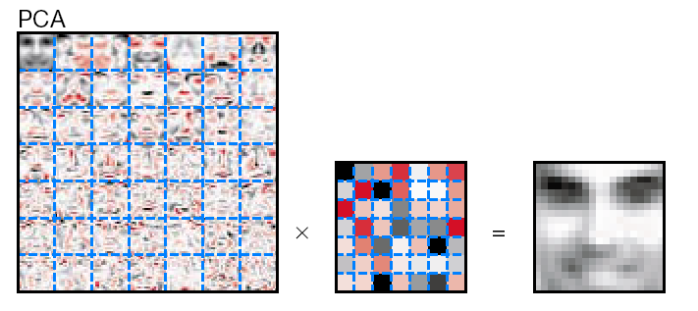
PCA Review
Find a set of orthogonal principal components (basis)
The reconstructed image is a linear combination of the principal components plus mean face
Coefficients

Slide 39
What we do not like about PCA?
PCA involves adding up some basis vectors then subtracting others
Basis vectors aren’t physically intuitive (negative) for many applications, e.g. documents
Subtracting doesn’t make sense in context of some applications
How do you subtract a face?
What does subtraction mean in the context of document classification?

Slide 40
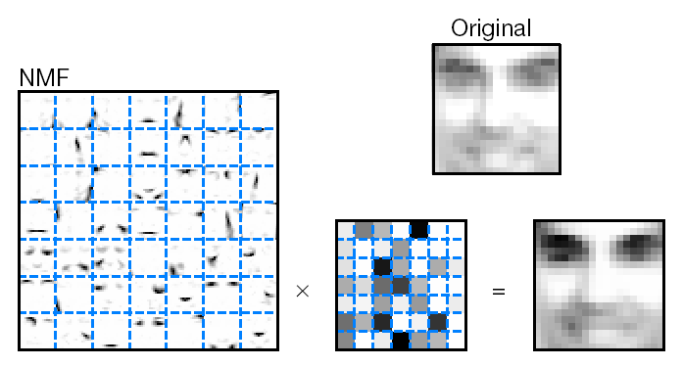
Non-negative Matrix Factorization
Like PCA, except that the coefficients in the linear combination cannot be negative
Coefficients
Proposed by D. Lee and H. Seung (NIPS 2000)

Slide 41
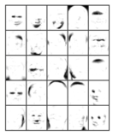
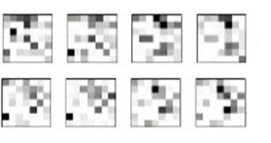
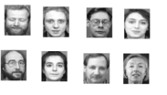
Non-negative Matrix Factorization
Matrix factorization: V≈WH
V: n×m matrix. Each column of which contains n nonnegative pixel values of one of the m facial images.
W: (n×r): r columns of W are called basis images.
H: (r×m): each column of H is called encoding.
……
V: an image is a column vector
W: a basis image is a column vector
H: a coefficient vector (shown as matrix
here) is a column vector

Slide 42
NMF Basis Vectors
Only allowing adding basis vectors makes intuitive sense
Has physical similarity in neurons
Forcing the reconstruction coefficients to be nonnegative leads to nice basis vectors
To reconstruct vector (image), all you can do is to add in more basis vectors
This leads to basis vectors that represent parts

Slide 43
Objective Function
Assume V is the sample matrix, the task is to approximate the original data matrix with two nonnegative data matrices:
Let the value of a pixel in the original input image be V_{iµ}. Let (WH)_{iµ} be the reconstructed pixel.
$V_{iμ}=(W{H)}_{iμ}=\sum_{a=1}^{r}{W_{ia}H_{aμ}}$

Slide 44
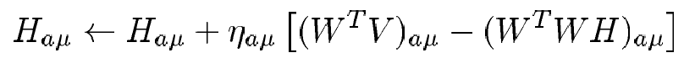
How do we derive the update rules (H only, W similar)?
Use gradient descent to find a local minimum
The gradient descent update rule is:
Try by yourself

Slide 45

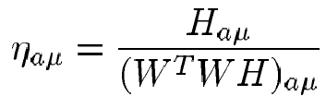
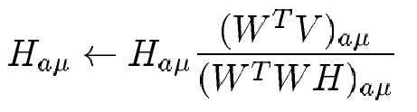
Deriving Update Rules (H only, W similar)
Gradient Descent Rule:
Set
The update rule becomes
Try by yourself

Slide 46
What’s significant about this?
This is a multiplicative update
If the initial values of W and H are all non-negative, then the W and H can never become negative.
This lets us produce a non-negative factorization
See NIPS Paper for full proof that this will converge if you are interested.
http://papers.nips.cc/paper/1861-algorithms-for-non-negative-matrix-factorization.pdf

Slide 47
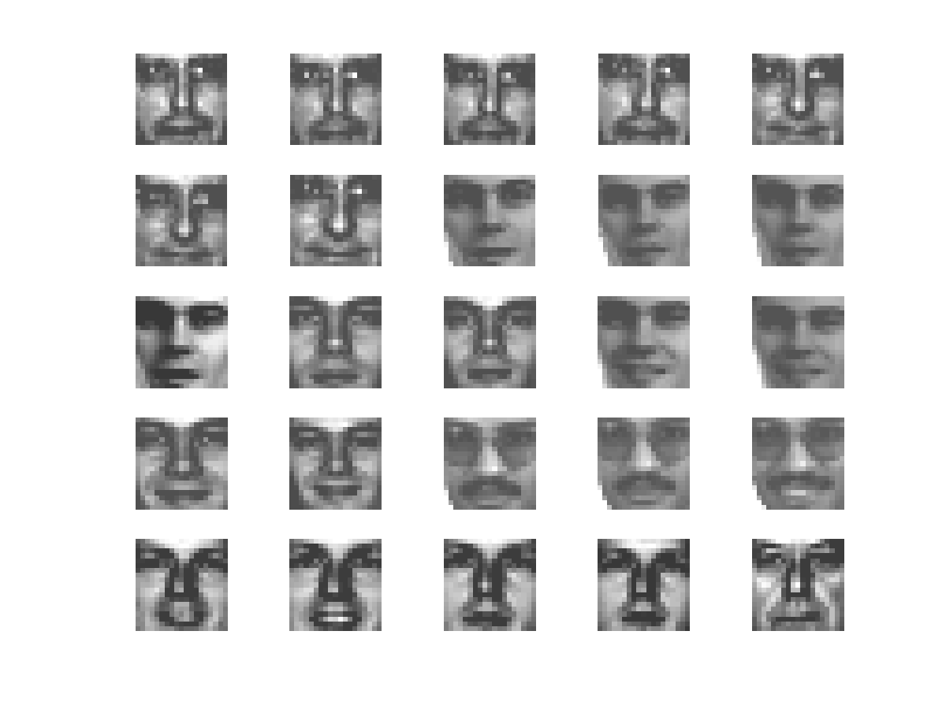
Example: Faces
Training set: 2429 examples
First 25 examples shown at right
Set consists of 19x19 face images

Slide 48
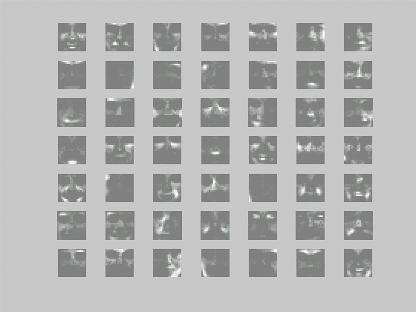
Example: Faces
Basis Images:
Basis no.: 49
Iterations: 50
How to draw this figure?

Slide 49
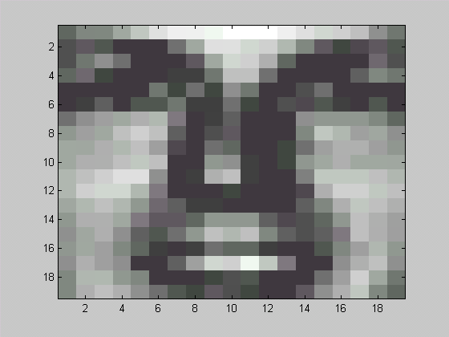
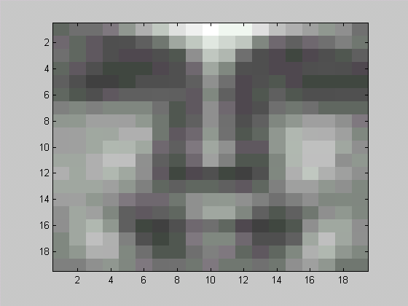
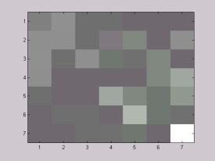
Face Reconstruction from Basis Vectors
Original
W
x
=
How to get h?
h
W * h

Slide 50
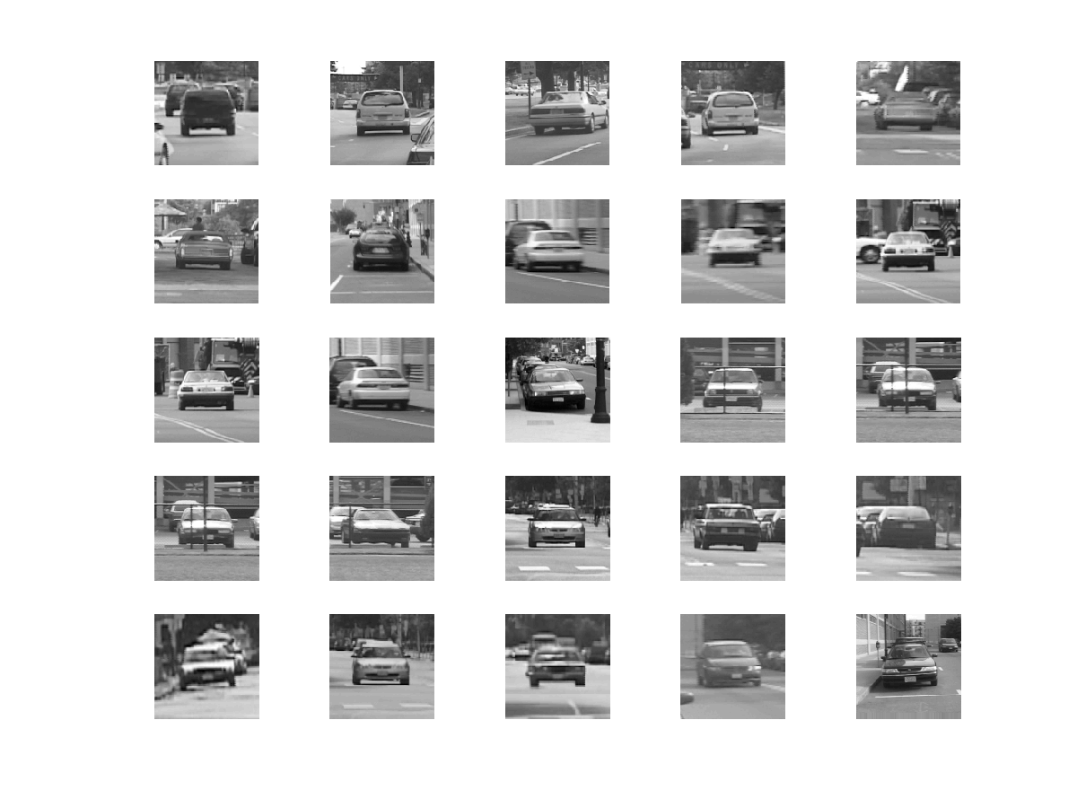
Example: Cars
Training set: 200 examples
First 25 examples shown at right
Set consists of car images taken at various orientations

Slide 51
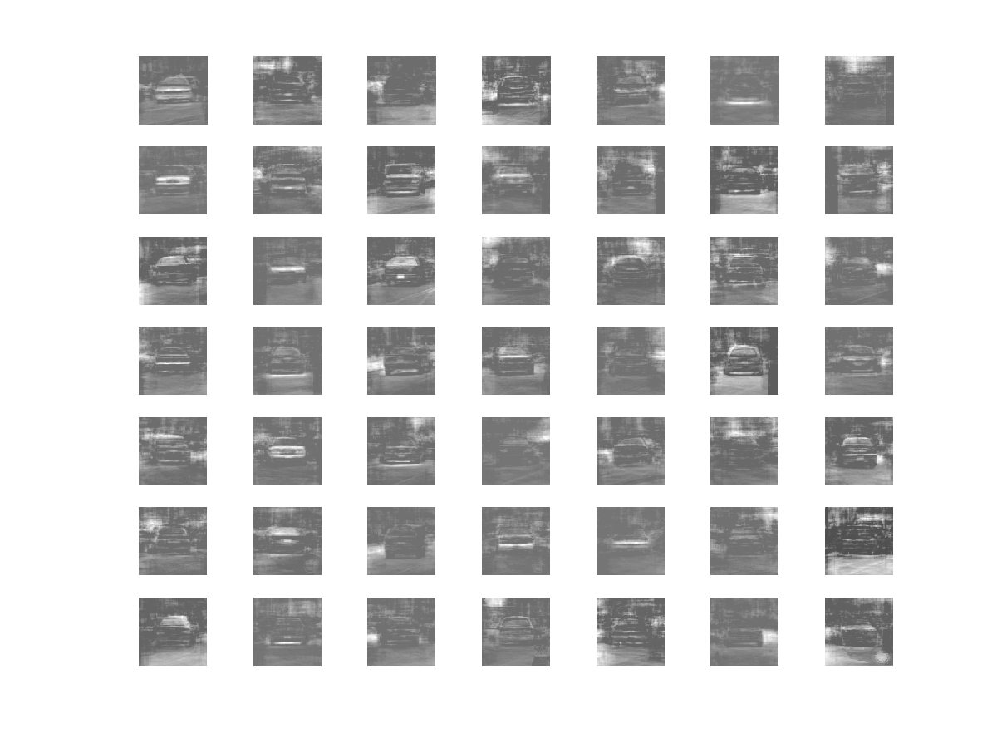
Example: Cars
Basis Images
Basis no.: 49
Iterations: 310

Slide 52

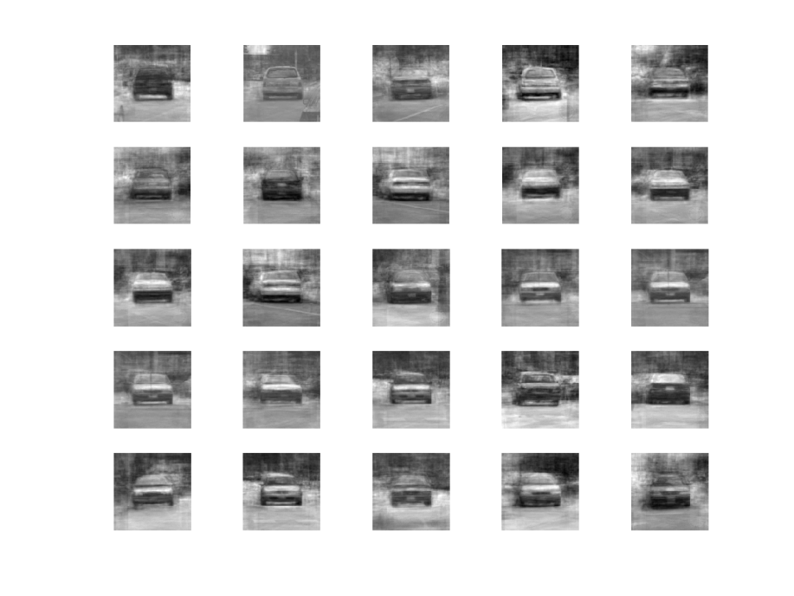
Car Reconstruction from Basis Vectors
Originals (1-25)
Output (1-25)

Slide 53
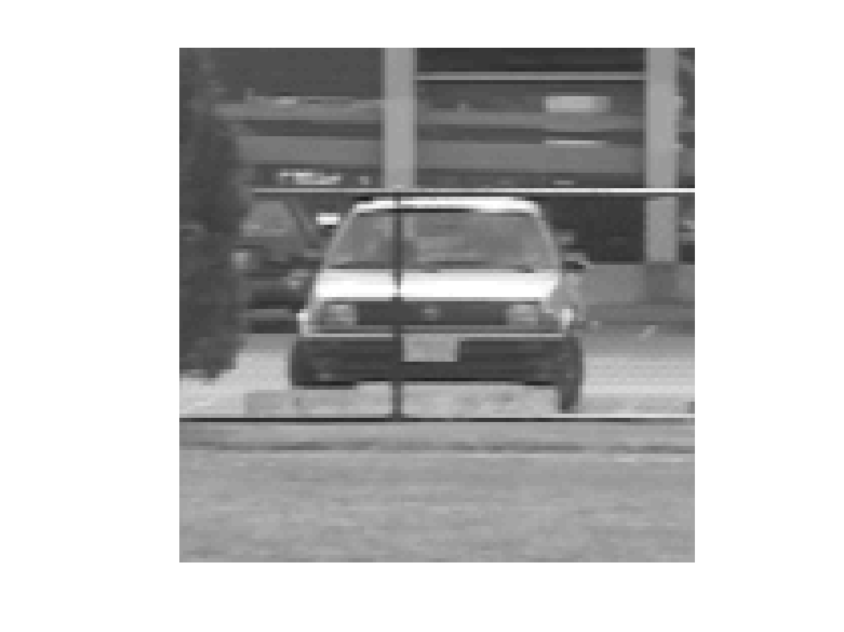
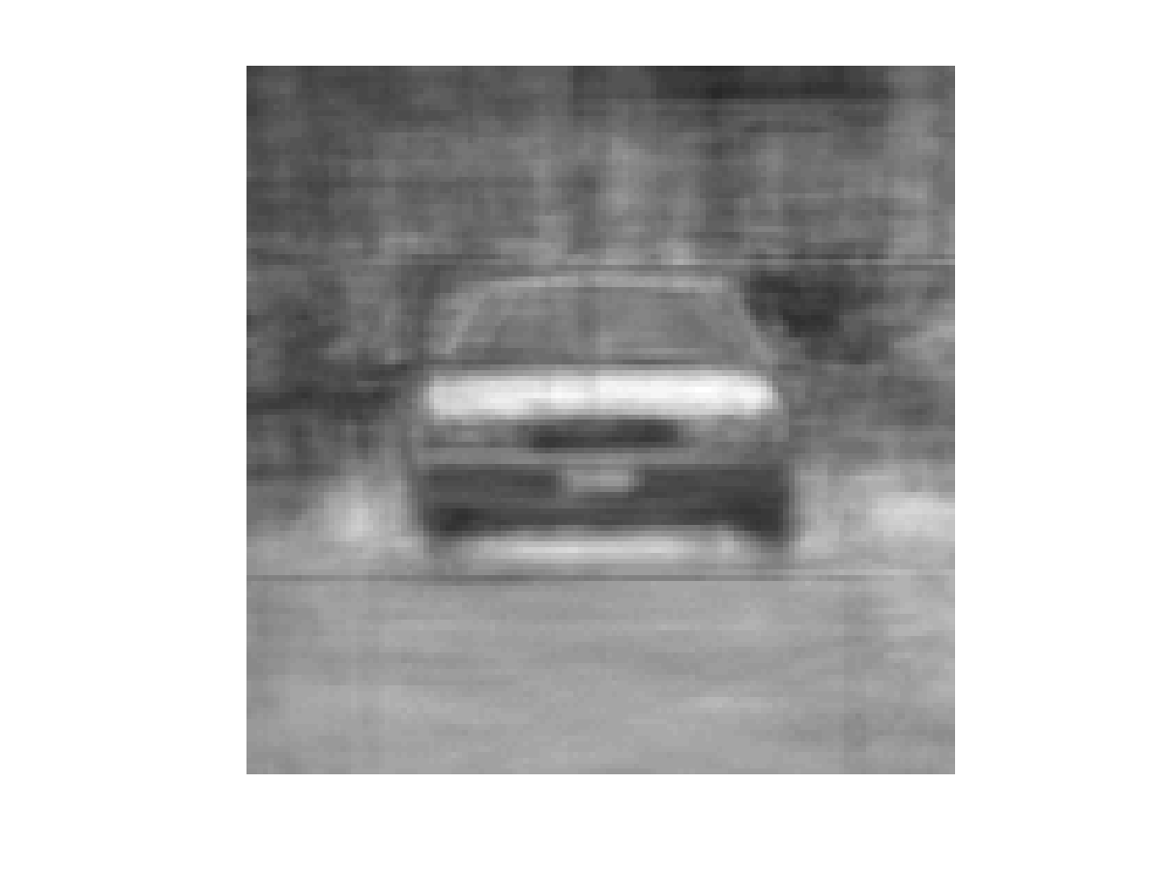
Car Reconstruction from Basis Vectors
Original image
Reconstructed image
Why fence disappeared?

Slide 54
Discussions
For new image, how to obtain the reconstruction coefficients?
How to use NMF for classification, e.g. face recognition?

Slide 55
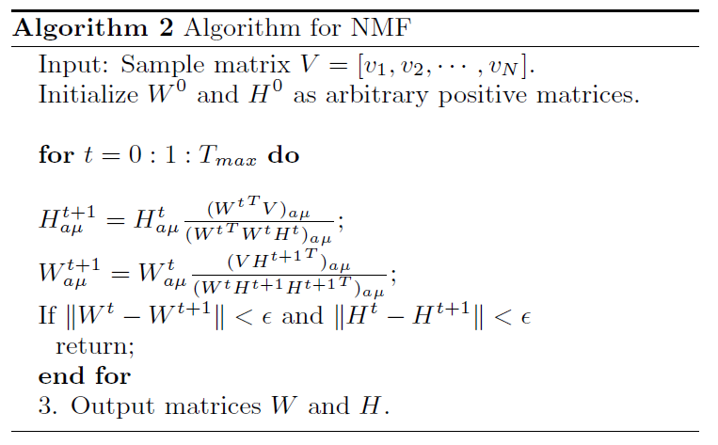
Summary of NMF

Slide 56
Discussions
What are differences between NMF and PCA?
 | NMF | PCA
Representation | Part-based | Holistic
Basis Image | Localized features | Eigenfaces
Constrains on W and H | Allow multiple basis images to represent a face but only additive combinations | Each face is approximated by a linear combination of all eigenfaces

Slide 57
Read and Self-Study
Bishop, Pattern Recognition Machine Learning:
Chapter 12, Section 12.1
D. Lee and H. Seung. Algorithms for Non-negative Matrix Factorization NIPS (2000).
ICA (Independent Component Analysis): http://en.wikipedia.org/wiki/Independent_component_analysis
CCA (Canonical Correlation Analysis): http://citeseerx.ist.psu.edu/viewdoc/download?doi=10.1.1.101.6359&rep=rep1&type=pdf

